Slide 1
This is CS50

Slide 2
http-server

Slide 3
GET / HTTP/1.1
...

Slide 4
GET /index.html HTTP/1.1
...

Slide 5
GET /search?q=cats HTTP/1.1
...

Slide 6
from flask import Flask

Slide 7
application.py
requirements.txt
static/
templates/

Slide 8

Notes:
https://en.wikipedia.org/wiki/Model%E2%80%93view%E2%80%93controller

Slide 9
from http.server import HTTPServer
Notes:
TODO: simplify code, add serve1.py that uses request line, add serve2.py that serves files

Slide 10
from flask import Flask, render_template
app = Flask(__name__)
@app.route("/")
def index():
return render_template("index.html")

Slide 11
request.args
request.form

Slide 12
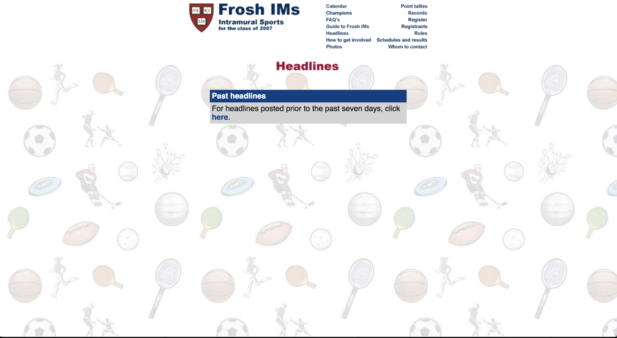

Slide 13
session

Slide 14
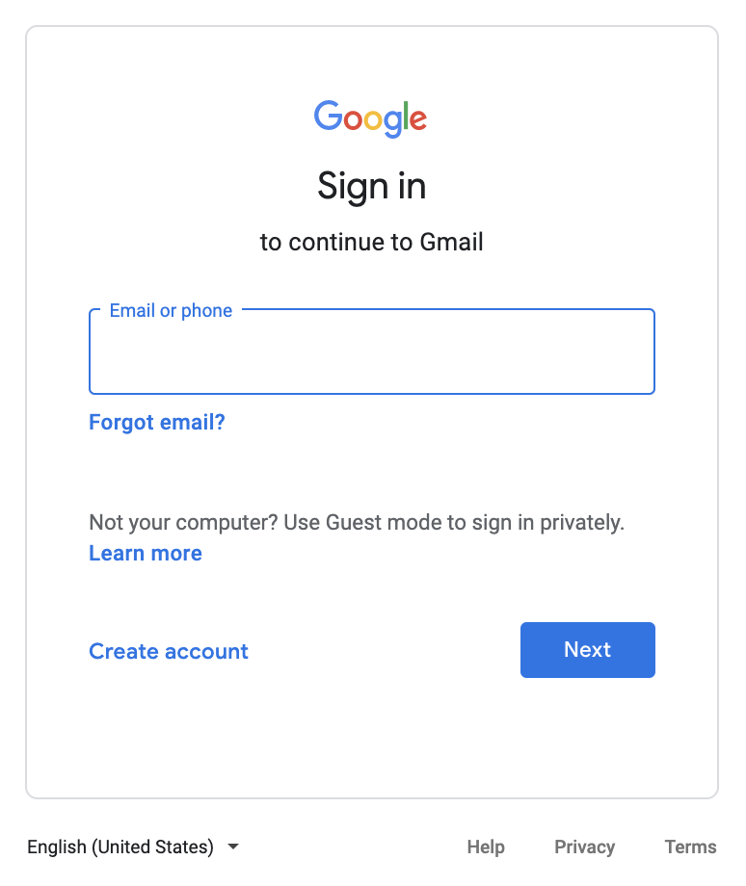

Slide 15
GET / HTTP/1.1
Host: gmail.com
...

Slide 16
HTTP/1.1 200 OK
Content-Type: text/html
...

Slide 17
HTTP/1.1 200 OK
Content-Type: text/html
Set-Cookie: session=value
...

Slide 18
GET / HTTP/1.1
Host: gmail.com
...

Slide 19
GET / HTTP/1.1
Host: gmail.com
Cookie: session=value
...

Slide 20
This is CS50

